Slide 1
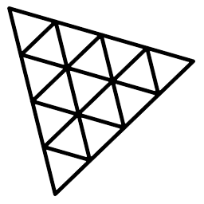
Three.js
3.JS
is
awesome
GUIDE FOR BEGINNERS
PROJECT PROPOSAL

Slide 2
TOPIC 19:
ABOUT
BUDGET
PROJECT
TIMELINE
RayCaster
PROJECT PROPOSAL

Slide 3
WHAT IS RAYCASTING
TABLE OF CONTENTS
EXAMPLES
BASIC THINGS IN RAYCASTING
RAYCASTING IN BASIC SCENE
WHAT IS RAYCASTING
EXAMPLES
BASIC THINGS IN RAYCASTING
RAYCASTING IN BASIC SCENE
01
02
03
04
PROJECT PROPOSAL

Slide 4

What is Raycasting
WHAT IS RAYCASTING
EXAMPLES
BASIC THINGS IN RAYCASTING
RAYCASTING IN BASIC SCENE
01

Slide 5
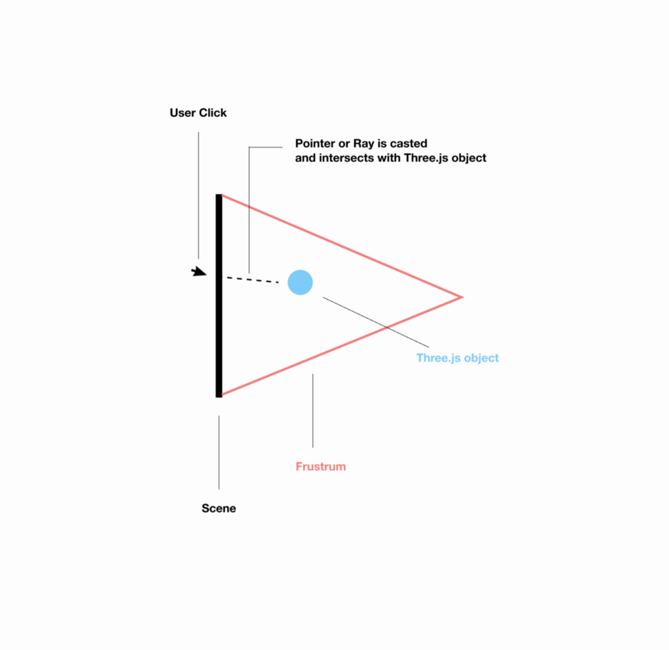
WHAT IS RAYCASTING
EXAMPLES
BASIC THINGS IN RAYCASTING
RAYCASTING IN BASIC SCENE
Raycasting is used for mouse picking (working out what objects in the 3d space the mouse is over) amongst other things.
Its the best way to determine what your mouse is pointing to in 3d scene.
A ray that emits from an origin in a certain direction, as the name suggests, a Raycaster can cast (or shoot) a ray in a specific direction and test what objects intersect with it.
the process of figuring out which object a user clicked on or touched

Slide 6
WHAT IS RAYCASTING
EXAMPLES
BASIC THINGS IN RAYCASTING
RAYCASTING IN BASIC SCENE

Slide 7

Examples
WHAT IS RAYCASTING
EXAMPLES
BASIC THINGS IN RAYCASTING
RAYCASTING IN BASIC SCENE
02

Slide 8
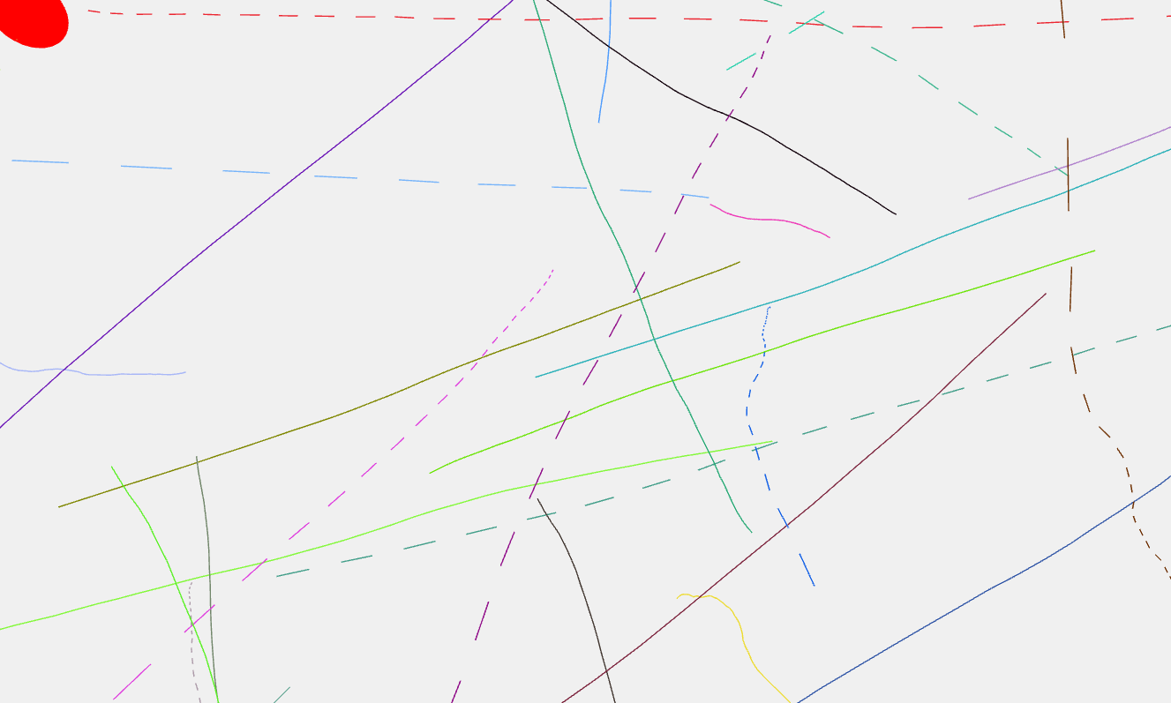
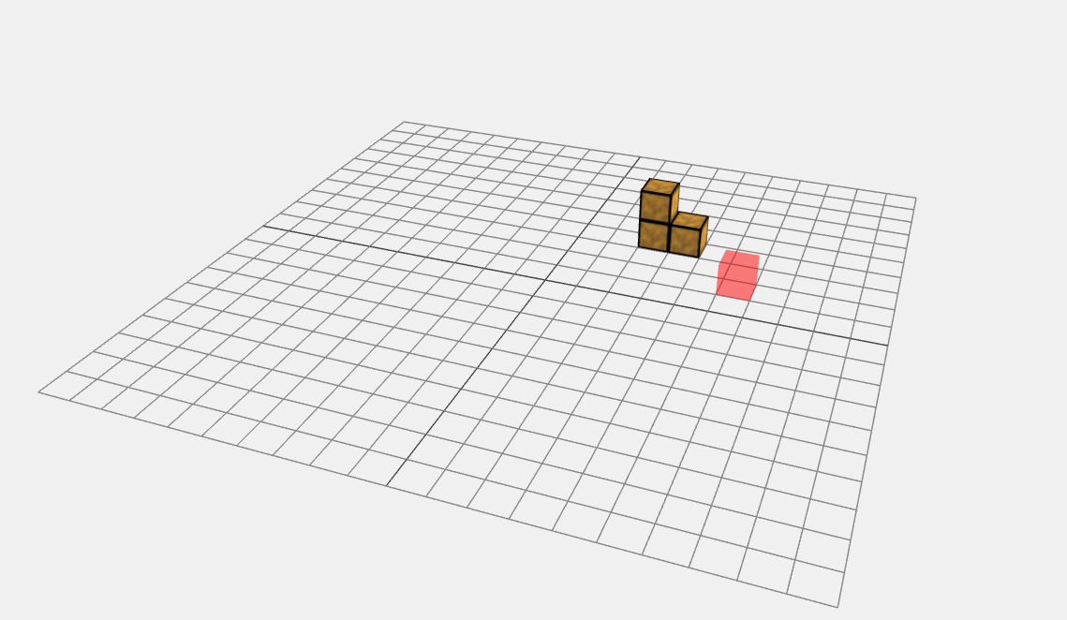
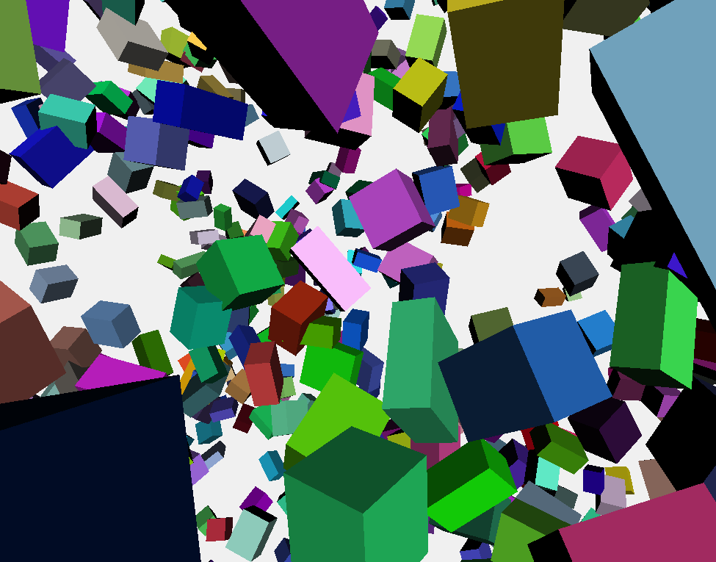
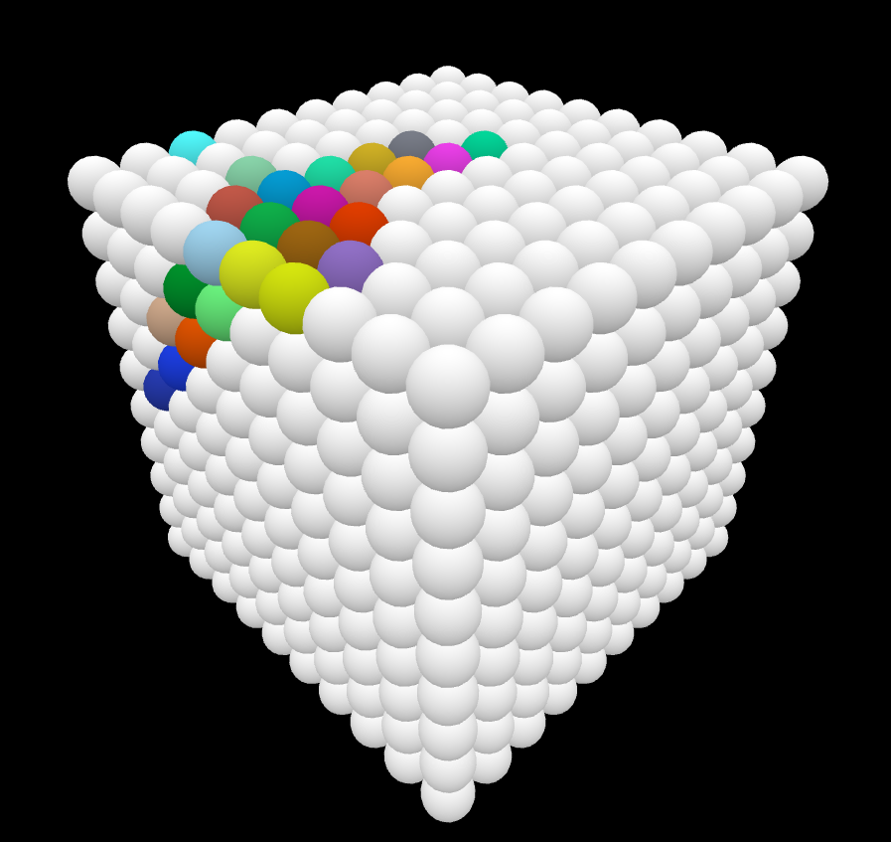
TO LINE
WHAT IS RAYCASTING
EXAMPLES
BASIC THINGS IN RAYCASTING
RAYCASTING IN BASIC SCENE
Click to view the examples below to see what can you do with Raycaster
TO PAINT VOXELS
MAKES LINES INTERACTIVE
CLICK TO CREATE SHIFT+CLICK TO DELETE
TO A MESH
TO COLOR CUBE
COLOR CHANGES
FILLS COLORS

Slide 9
Basic Things in Raycasting
WHAT IS RAYCASTING
EXAMPLES
BASIC THINGS IN RAYCASTING
RAYCASTING IN BASIC SCENE
03

Slide 10
WHAT IS RAYCASTING
EXAMPLES
BASIC THINGS IN RAYCASTING
RAYCASTING IN BASIC SCENE
Basic Scene
The basic scene
new THREE.Raycaster()
This instantiates raycaster
raycaster.setFromCamera(coord,camera)
Sets the pointer/ray with an origin and direction
Parameters:
1. coords — 2D coordinates of the mouse, in normalized device coordinates X and Y components should be between -1 and 1. 2. camera — camera from which the ray should originate
raycaster.intersectObjects(scene.children)
checks object array for any intersecting objects
Call the raycaster method intersectObjects. This method takes in an object and returns an array of intersected objects. If there are no intersecting objects, an empty array will get returned.

Slide 11
WHAT IS RAYCASTING
EXAMPLES
BASIC THINGS IN RAYCASTING
RAYCASTING IN BASIC SCENE
New Vector2();
The Vector2 takes in 2 number parameters Vector2( x, y). These numbers can be used for different reasons but one of the most common is to set a coordinate in the scene
THREE.Object3D;
This is the base class for most objects in three.js and provides a set of properties and methods for manipulating objects in 3D space.
clientX
The clientX property returns the horizontal coordinate (according to the client area) of the mouse pointer
clientY
The clientX property returns the vertical coordinate (according to the client area) of the mouse pointer

Slide 12
Basic Scene in raycasting
WHAT IS RAYCASTING
EXAMPLES
BASIC THINGS IN RAYCASTING
RAYCASTING IN BASIC SCENE
04

Slide 13
WHAT IS RAYCASTING
EXAMPLES
BASIC THINGS IN RAYCASTING
RAYCASTING IN BASIC SCENE
Basic Scene:
Lets suppose we have a basic scene with 3 cubes and a plane.
// CANVAS
const canvas=document.getElementById('webglGee')
//SCENE
const scene=new THREE.Scene();
//PLANE
const plane=new THREE.Mesh(new THREE.PlaneGeometry(5,5),
new THREE.MeshBasicMaterial({side:THREE.DoubleSide}))
scene.add(plane)
plane.position.set(0,0,0)
plane.rotation.set(0,0,0)
//CUBE 1
const obj1=new THREE.Mesh(new THREE.BoxGeometry(0.5,0.5,0.5),
new THREE.MeshBasicMaterial({color:'red',transparent:true}))
scene.add(obj1)
obj1.position.set(-1,0,0.25)

Slide 14
WHAT IS RAYCASTING
EXAMPLES
BASIC THINGS IN RAYCASTING
RAYCASTING IN BASIC SCENE
//CUBE 2
const obj2=new THREE.Mesh(new THREE.BoxGeometry(0.5,0.5,0.5), new THREE.MeshBasicMaterial({color:'black',transparent:true}))
scene.add(obj2)
obj2.position.set(0,0,0.25)
//CUBE 3
const obj3=new THREE.Mesh(new THREE.BoxGeometry(0.5,0.5,0.5), new THREE.MeshBasicMaterial({color:'blue',transparent:true}))
scene.add(obj3)
obj3.position.set(1,0,0.25)
//CAMERA
const camera=new THREE.PerspectiveCamera(80,window.innerWidth/window.innerHeight,1,1000)
scene.add(camera)
camera.position.set(0,-4,4)
camera.rotation.set(1,0,0)
//RENDERER
const renderer=new THREE.WebGLRenderer({canvas:canvas})
renderer.setSize(window.innerWidth,window.innerHeight)
//ANIMATION
const anim=()=>{
requestAnimationFrame(anim)
renderer.render(scene,camera)
}
anim();

Slide 15
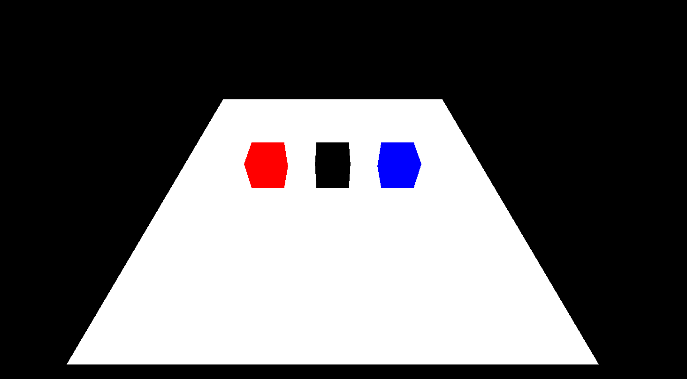
WHAT IS RAYCASTING
EXAMPLES
BASIC THINGS IN RAYCASTING
RAYCASTING IN BASIC SCENE

Slide 16
WHAT IS RAYCASTING
EXAMPLES
BASIC THINGS IN RAYCASTING
RAYCASTING IN BASIC SCENE
Then we will have some datas of the cubes and plane. Like;
obj1.userData.draggable=true;
obj2.userData.draggable=true;
obj3.userData.draggable=true;
obj1.userData.name="red";
obj2.userData.name="black";
obj3.userData.name="blue";
plane.userData.ground=true;
Then we will instantiate the RAYCASTER object and other objects. Like;
const raycaster=new THREE.Raycaster();
const clickingMouse=new THREE.Vector2();
const movingMouse=new THREE.Vector2();
var isDraggable=THREE.Object3D;

Slide 17
WHAT IS RAYCASTING
EXAMPLES
BASIC THINGS IN RAYCASTING
RAYCASTING IN BASIC SCENE
window.addEventListener('click',(e)=>{
//1
clickingMouse.x=(e.clientX/window.innerWidth)*2-1;
clickingMouse.y=-(e.clientY/window.innerHeight)*2+1;
raycaster.setFromCamera(clickingMouse,camera)
const intersecting=raycaster.intersectObjects(scene.children);
//3
if(isDraggable && isDraggable.userData!==undefined){
isDraggable.material.opacity=1
isDraggable=null;
console.log('drop obj');
return false;
}
//2 if(intersecting.length>1){
isDraggable=intersecting[0].object
console.log('pick obj');
isDraggable.material.opacity=0.7
}
})

Slide 18
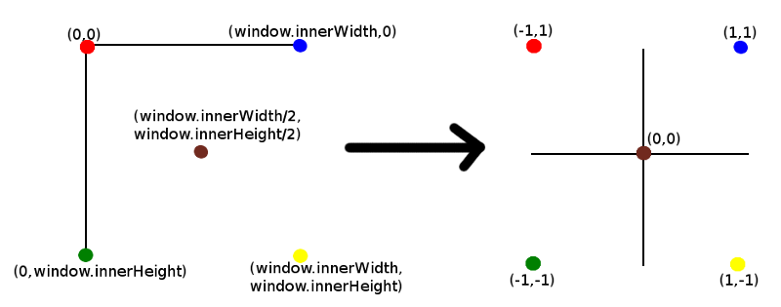
WHAT IS RAYCASTING
EXAMPLES
BASIC THINGS IN RAYCASTING
RAYCASTING IN BASIC SCENE

Slide 19
WHAT IS RAYCASTING
EXAMPLES
BASIC THINGS IN RAYCASTING
RAYCASTING IN BASIC SCENE
window.addEventListener('mousemove',(e)=>{
movingMouse.x=(e.clientX/window.innerWidth)*2-1;
movingMouse.y=-(e.clientY/window.innerHeight)*2+1;
if(isDraggable){
raycaster.setFromCamera(movingMouse,camera)
const intersecting=raycaster.intersectObjects(scene.children)
if(intersecting.length>0){
for(let o of intersecting){
if(isDraggable.position && o.object.userData.ground){
console.log(isDraggable.position);
isDraggable.position.x=o.point.x
isDraggable.position.y=o.point.y
}
}
}
}
})

Slide 20
THANKS!
ABOUT
BUDGET
PROJECT
TIMELINE
Do you have any questions?
EMAIL: aadnanshahh2001@gmail.com
GITHUB: https://github.com/AdnanShahSahb
Please keep this slide for attribution
PROJECT PROPOSAL

